Slide 1
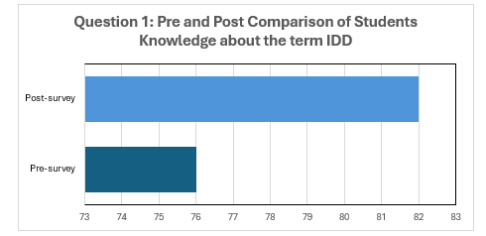
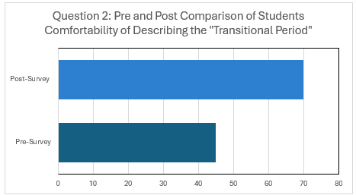
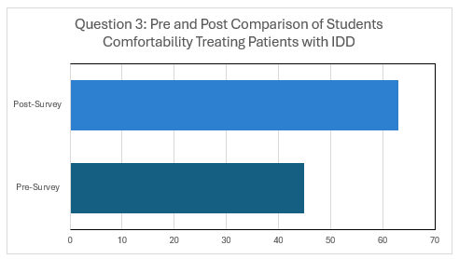
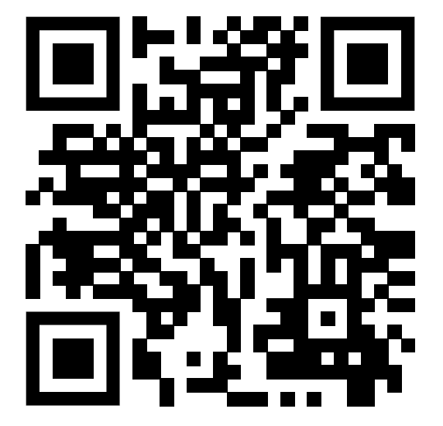
Bridging the Gap: Occupational Therapy Student’s Perspectives on Youth with Intellectual and Developmental Disabilities
Madison Wittekind S/OT
Introduction
Recruitment
Results
Results
During the transition-period, individuals with intellectual and developmental disabilities (IDD) often encounter significant challenges independently performing activities of daily living (ADLs) and instrumental activities of daily living (IADLs) (Leonard et al., 2016). ADLs include essential self-care tasks, while IADLs involve more complex activities required for managing life at home and in the community (AOTA, 2020).
Dependence on others for these tasks may contribute to feelings of frustration, reduced confidence, and vulnerability when compared to typically developing peers (Jansen-van & Aldersey, 2020). Additionally, many individuals with IDD experience limited access to occupational therapy services and supportive transition programs, further complicating their ability to achieve functional independence during the transition period (Gauthier-Boudreault et al., 2018).
Purposive sampling was used to recruit 23 occupational therapy doctoral students from Xavier University. Recruitment occurred in multiple stages: a study announcement was posted on Canvas to OCTD 600 pediatric course two weeks prior to the scheduled class session. On the day of the presentation a recruitment script was read informing participants of the project and risks involved. Instructions on the use of a pre and post survey were given. Participants were given the opportunity to ask questions regarding the informed consent and surveys in person.
Statistical outcomes:
  Statistically significant improvement across all pre-and post-survey questions (p < 0.05).
  Question 1: p-value of 0.0251 with a z-score of -2.24164, Question 2: p-value of <0.00001 with a z-score of -4.03729, and Question 3 p-value of 0.00026 with z-score of -3.64999.
Doctoral Capstone Student outcomes
  Improved presentation and group facilitation skills
  Increased confidence in teaching graduate-level students.
Design
Dependent variables
Project Description
Conducted during the regularly scheduled OCTD 600 Pediatrics course
23 students attended the class session.
22 students consented to participate in pre and post surveys.
Surveys were accessed via a QR code displayed in the PowerPoint
Presentation defined IDD and the role of occupational therapy in supporting transition-aged youth with IDD.
Activity 1: Students adapted a daily schedule to promote independence, accessibility, and participation for individuals with IDD.
Activity 2: Students analyzed case studies and developed interventions and short-term, client centered goals for each individual.
Discussion
Findings suggest that the presentation and activates were effective in improving students' knowledge, comfortability defining and working with transition aged youth with IDD.
Implications for OT Practice
Resident 1:
The developed PowerPoint and interactive activities demonstrate importance of educating future occupational therapy practitioners on their role in working with transition-aged youth with IDD.
Objective
To evaluate the effectiveness of a targeted presentation and interactive activities on transition-aged youth with IDD by measuring knowledge gained among second-year occupational therapy doctoral students.
References

